Slide 1

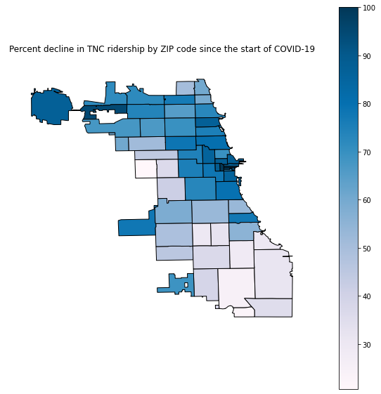
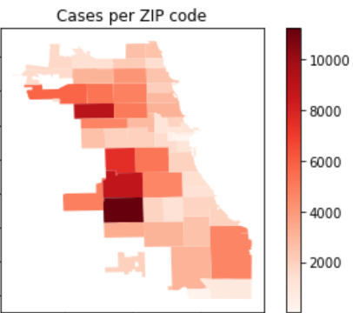
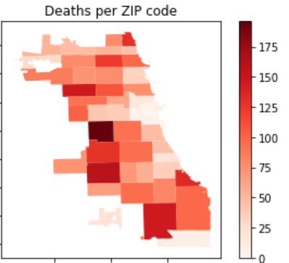
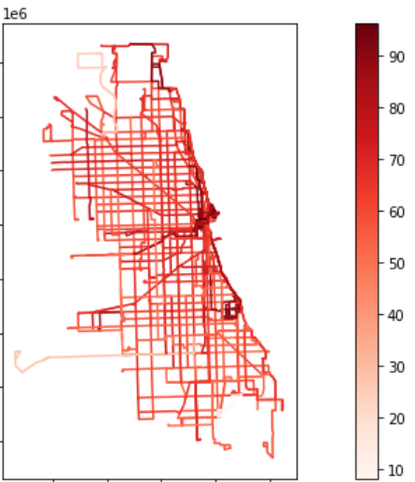
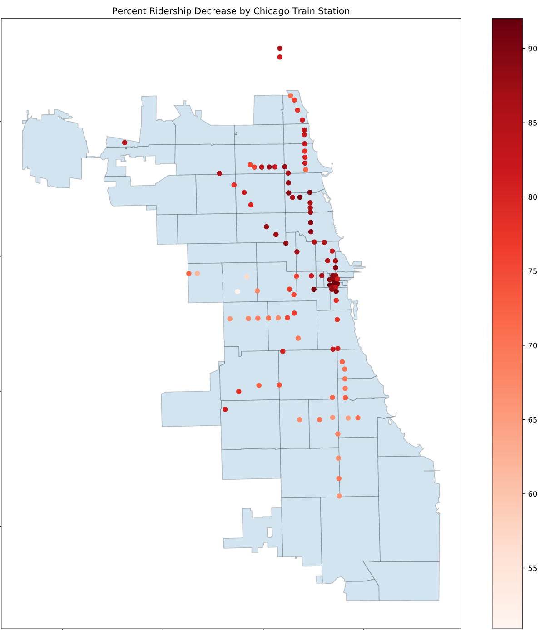
Effects of COVID-19 on Public Transportation Systems in Chicago, IL
Mentees: Aman Sekhon, Amey Venkatanarayan, Ethan Light, Mentor: Jesus Osorio
Grainger College of Engineering, University of Illinois at Urbana-Champaign
PURE Symposium May 3rd, 2021
Introduction
Table 1. Train Regression Results
Transportation Network Providers (e.g. Lyft, Uber)
COVID-19 quarantine orders disrupted all modes of transportation in significant ways.
Most transit system around the world suffered a drop in ridership of over 70%.
a | Estimate | Error | P-value
Death Rate | -23.78 | 9.137 | 0.011
Average Income | 6.799e-5 | 3.132e-5 | 0.032
Unemp. Rate | -0.2711 | 0.1995 | 0.18
Percent Black | -0.1335 | 3.432e-2 | 0.0019
R^2 | 0.67
Objectives
Observe and quantify the extend at which each mode of transportation in Chicago was affected by COVID-19.
Gather spatial data related to COVID-19 cases and deaths to determine any spatial correlation between the drop in ridership and these variables.
Gather socio-economic data to determine any spatial patterns between user groups and transit use.
Bus Ridership
Fig 4. Percent decline in ridership by Zip code since the start of COVID-19
Fig 1. Number of confirmed COVID-19 cases and deaths per zip code until Sept. 30, 2020.
Table 3. TNP Regression Results
Train Ridership
 | Estimate | Error | P-value
Unemp. Rate | -1.42 | 0.46 | 0.003
Percent Black | -0.2 | 0.08 | 0.016
Death Rate | -82.43 | 23.78 | 0.001
R^2 | 0.72
Fig 3. Percent decline in bus ridership by route since the start of COVID-19
Conclusions
Unemployment rate was the best predictor of ridership decline for trains.
The % black factor and death rate for all modes was statistically significant.
The TNP regression results' R^2 value indicates the examined factors best predict ridership decline for TNPs.
There is a clear spatial pattern for % decline in all modes between the Northeast and Southwest parts of the city which agree with COVID-19 spatial patterns.
Table 2. Bus Regression Results
 | Estimate | Error | P-value
Death Rate | -164.7 | 29.04 | 9.93e-08
Percent Black | 0.77 | 0.2 | 0.00014
R^2 | 0.41
Fig 2. Percent decline in train ridership by station since the start of COVID-19

